Slide 1
PCB Assembly
Dr. Steven Swanson
CSE176e/276e
swanson@cs.ucsd.edu

Slide 2
The PCB Assembly Process
Apply solder paste with a stencil
https://learn.adafruit.com/smt-manufacturing/squeegees
Place parts
Reflow in an oven
Solder on through-hole components.

Slide 3
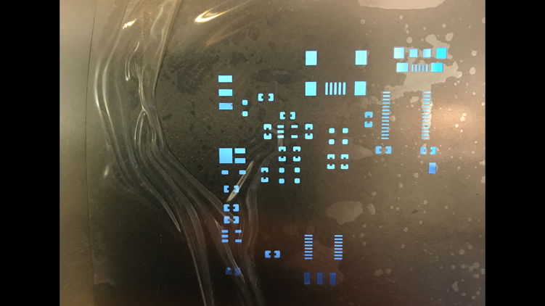
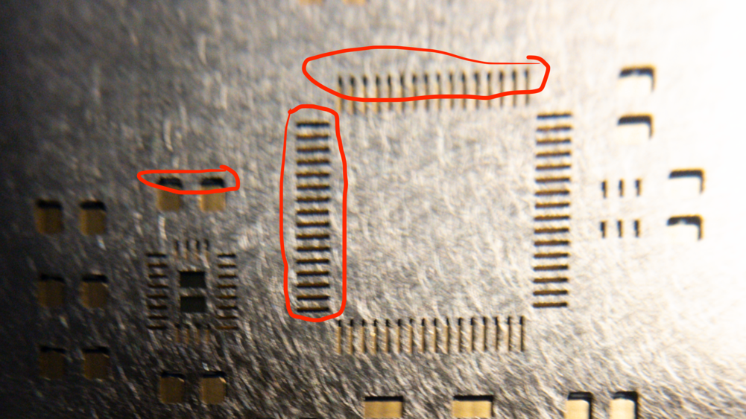
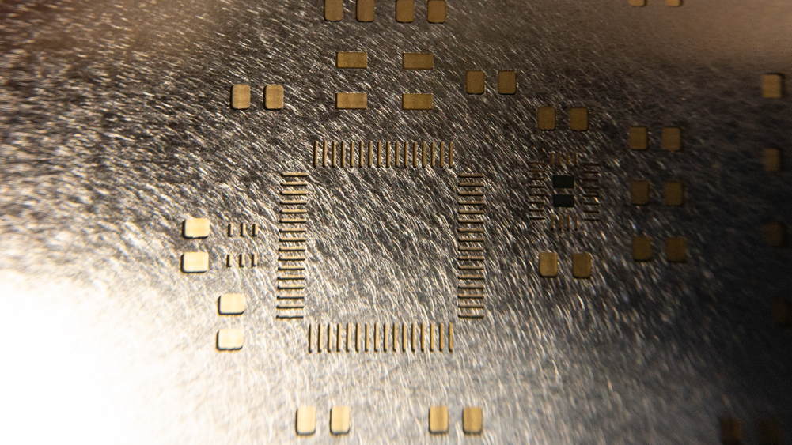
Align Stencil
Bad
Good

Slide 4
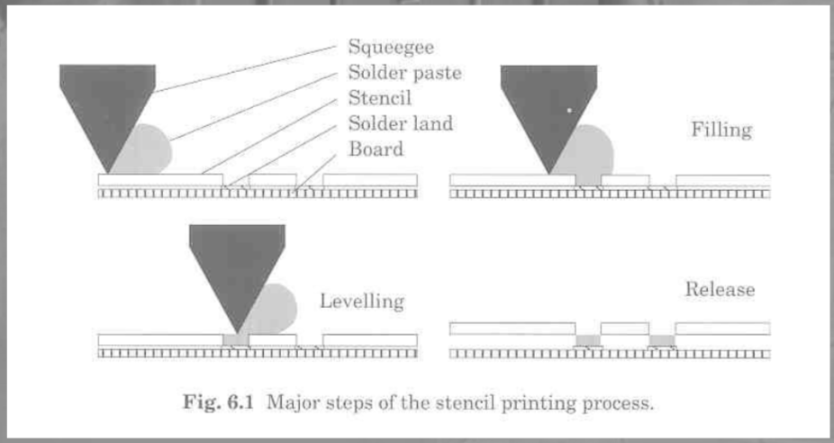
Solder Squeegees

Slide 5
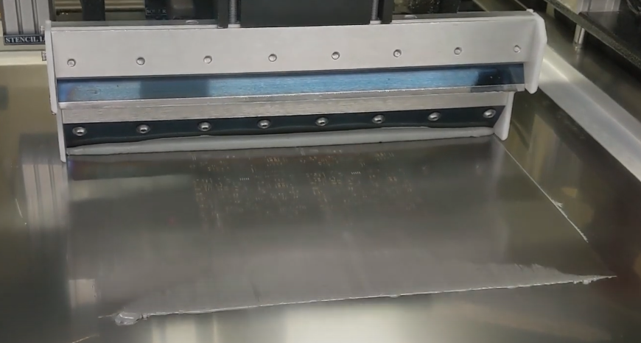
Commercial Squeegee
Paste is applied with a solder paste printer
Automatic Optical Inspection (AOI) checks application

Slide 6
Manual Squeegee
Photos: Adafruit.com

Slide 7
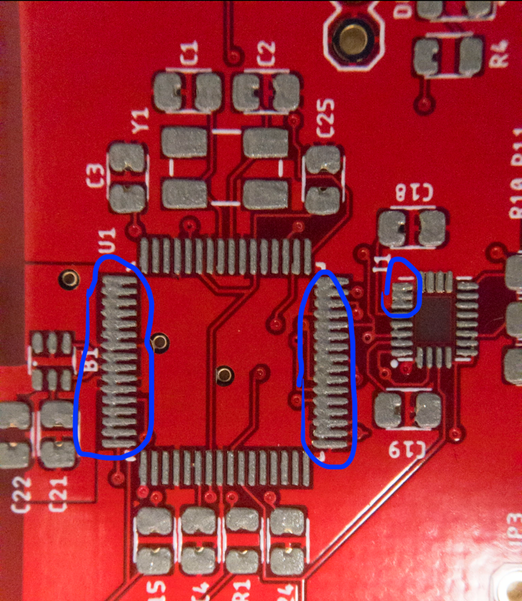
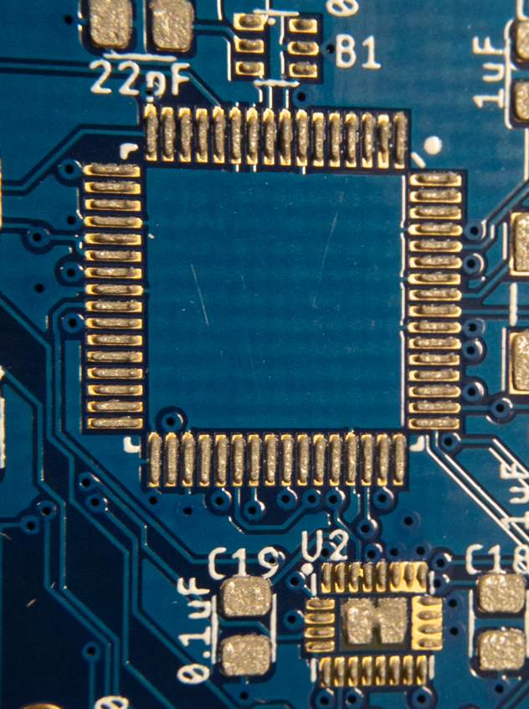
Manual Optical Inspection
Bad
Good

Slide 8
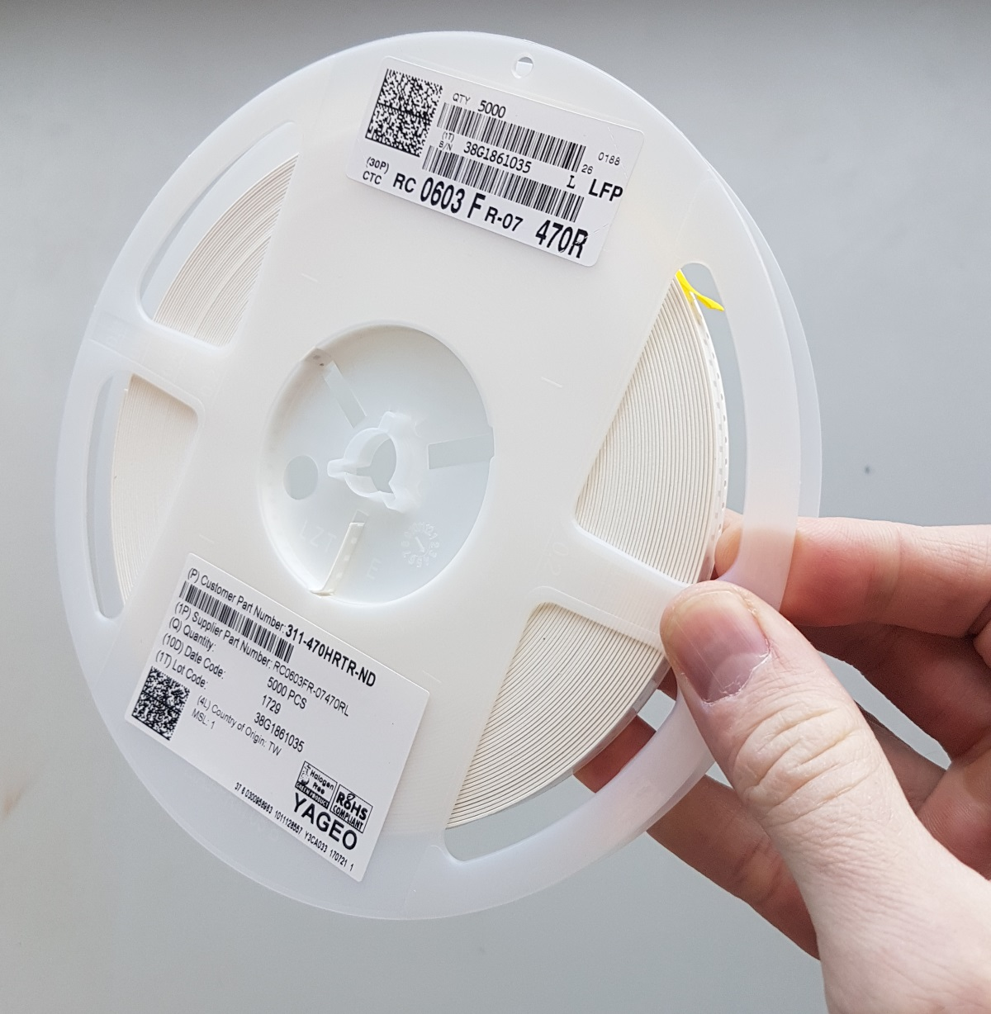
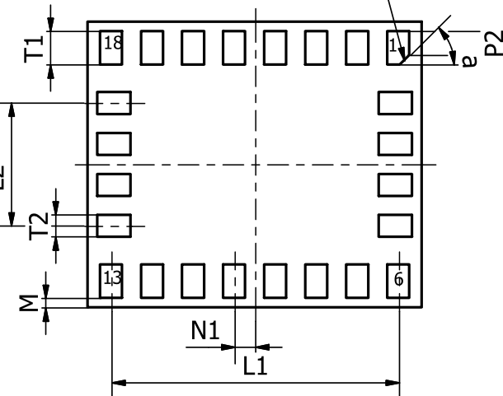
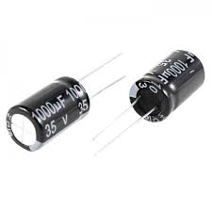
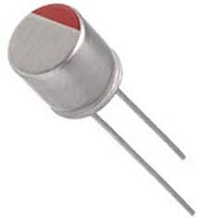
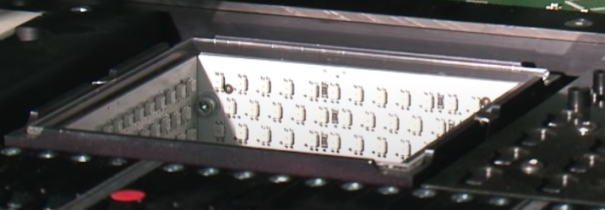
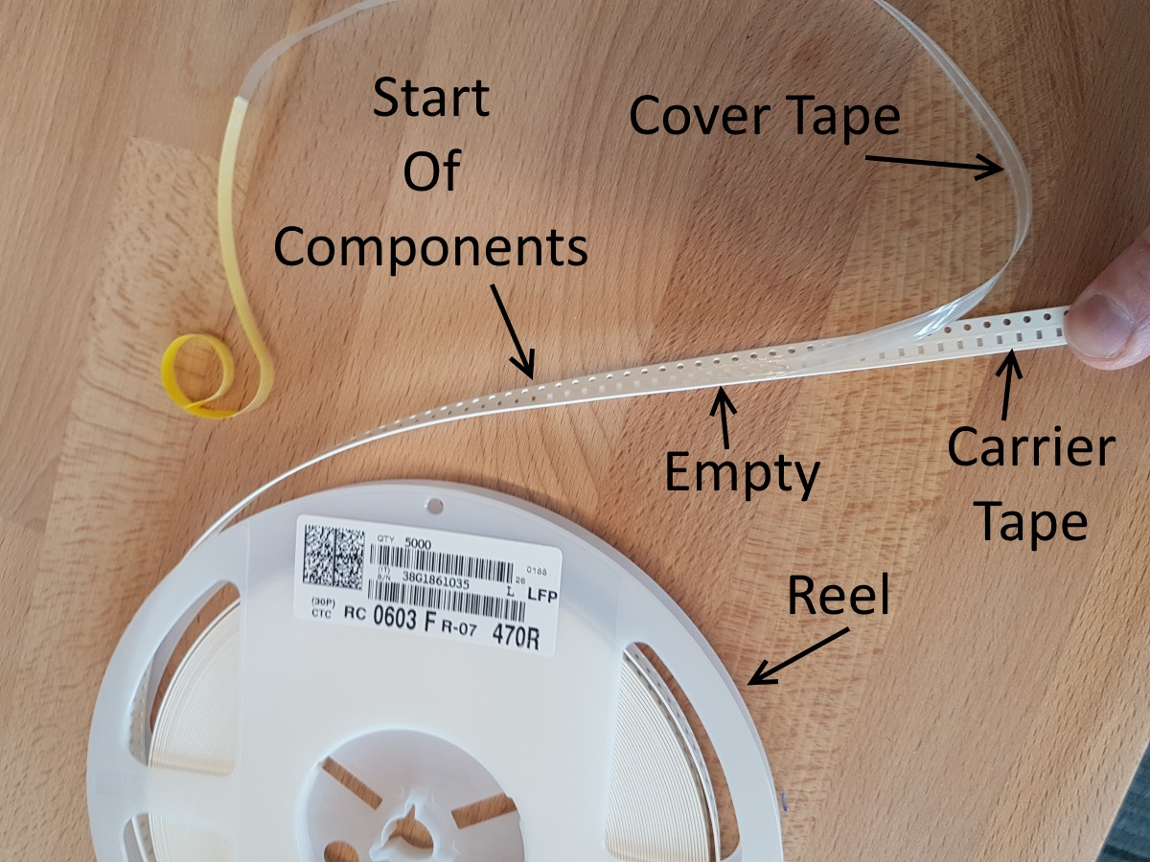
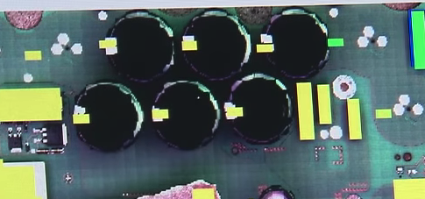
Part Placement: SMD
Pick and Place machines place parts
1000s of parts per minute
Parts feed from spools (e.g., 5000 resistors)

Slide 9
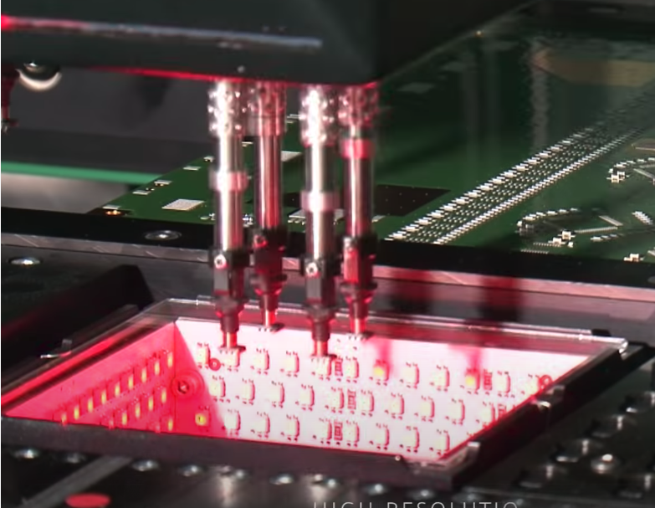
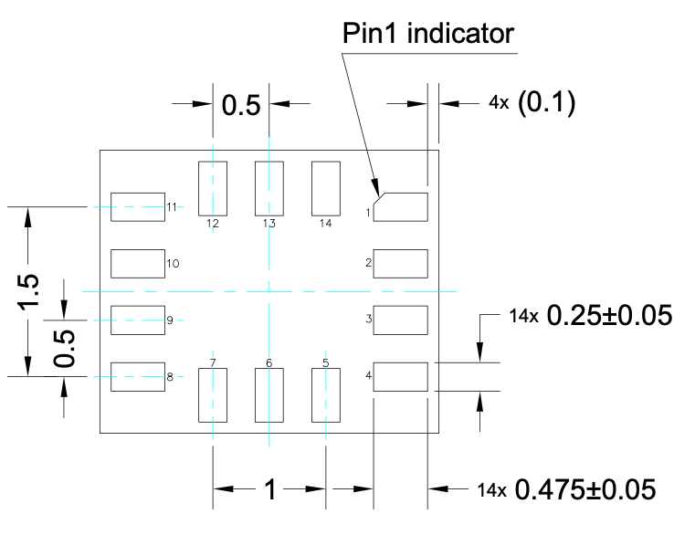
Part Placement: High Precision
Fine-pitch parts (CPUs, MCUs, IMUs, etc.) very precise alignment
PnP machines optically align parts
So, parts have pin 1 markers on the bottom

Slide 10
Automatic Optical Inspection (AOI) for Part Placement
Many parts have high-contrast markings on top
They show up on camera.

Slide 11
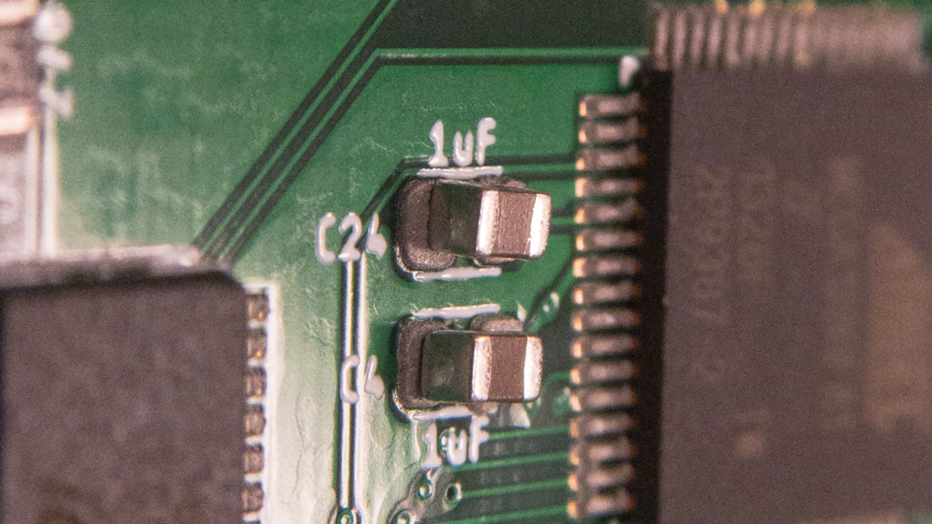
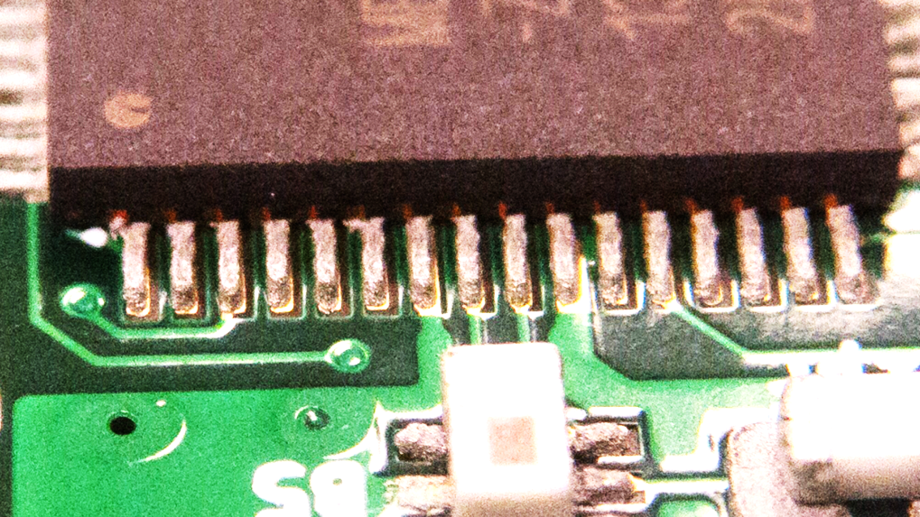
M(anual)OI for Part Placement
Bad
Good

Slide 12
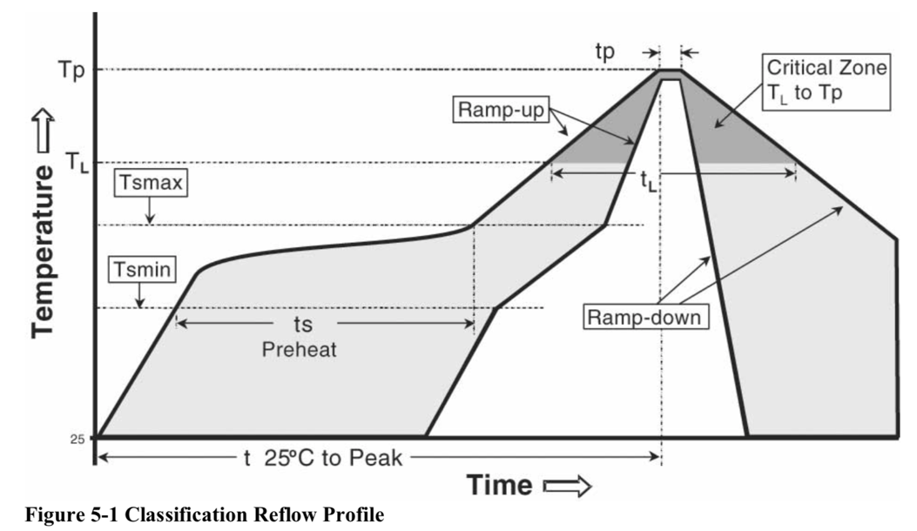
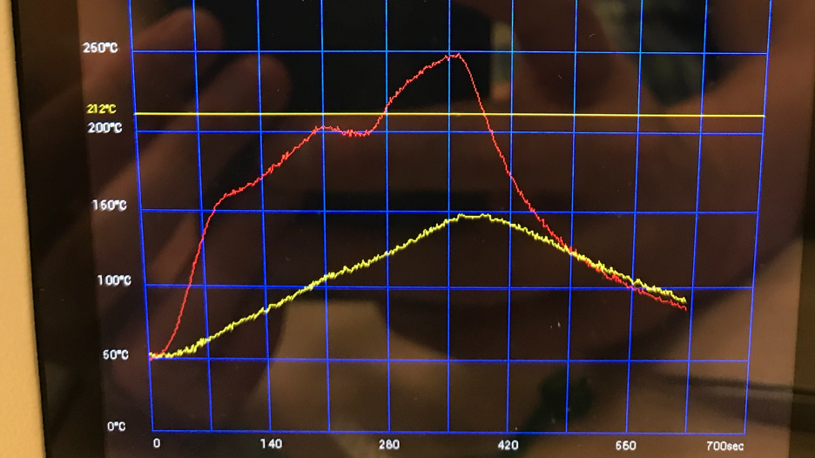
Reflow Soldering

Slide 13
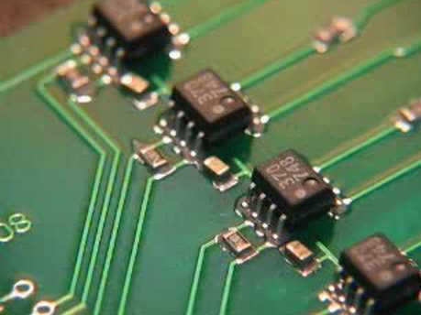
Reflow Video

Slide 14
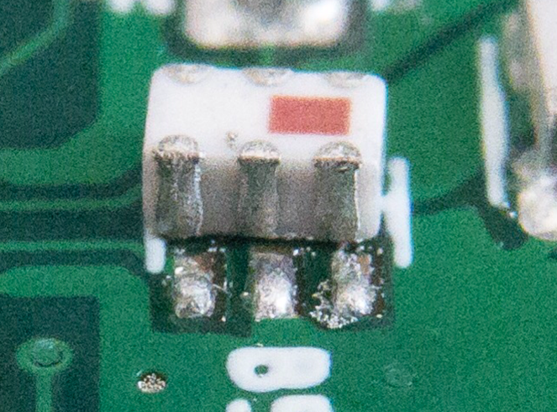
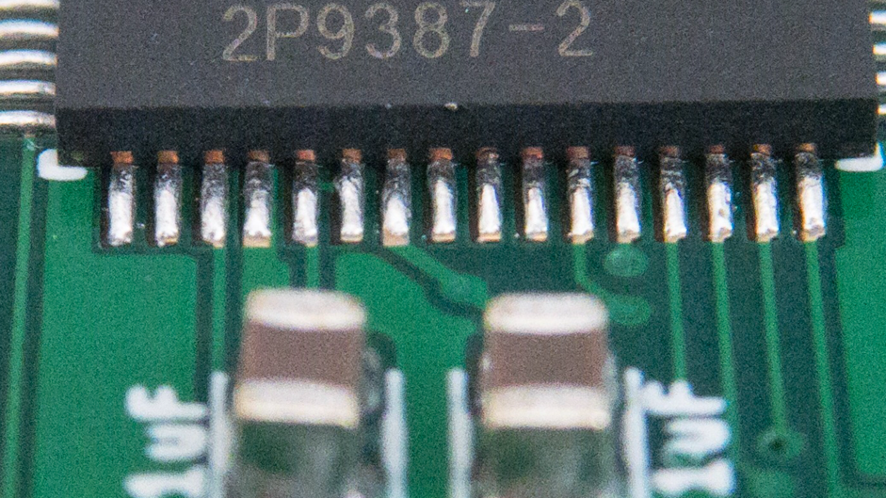
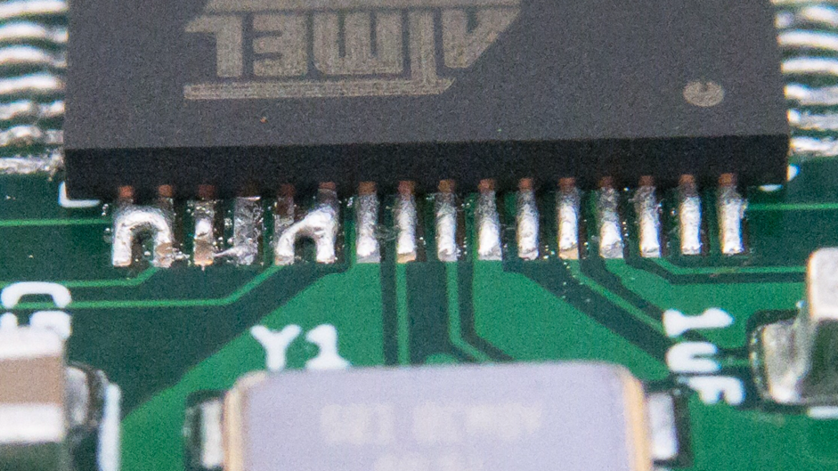
Reflow Soldering Results
Good
Bad

Slide 15
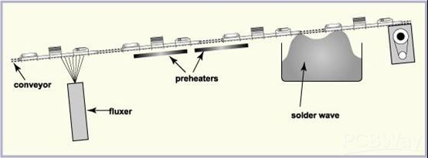
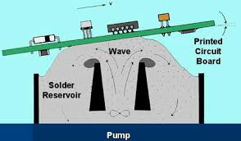
Wave Soldering
Automated through-hole soldering
A pool of molten solder is pumped into a wave
The boards slide over the top
Solder wicks up around pins
SMD is possible too, but you have to glue the parts to the board

Slide 16
Solder Joints

Slide 17
Tips for Assembly
Good source for stencils
https://www.oshstencils.com/
Solder Paste
Lead solder is much easier to work with (https://www.oshstencils.com/ sells it in small quantities)
Apply solder paste in one pass (ignore the internet, this is critical for fine-pitch parts)
Get some chem wipes and rubbing alcohol to clean up.
When in doubt, redo it.
Put down newspaper, wear gloves.
Reflowing
Lots of at-home techniques (hot plates, clothes irons, toaster ovens, etc.)
I find the hot air (paint stripper -- cheap) gun works best. We used to do this in class.
Lead solder melts at lower temp

Slide 18
Board Tape Out

Slide 19
Final Steps for Manufacturing
Give your board another thorough check
Submit once more for human review
Once approved, you are done with your board.
I’ll order them and we will ship them to you.

Slide 20
If you want to assemble the board yourself…
I will order what you need
Parts
A stencil
It’s pretty advanced soldering
I also have some older-model remote boards you can have
They basically work fine, but are not perfect (e.g., there is no power switch)
You’d need to buy the gimbals (https://www.amazon.com/FrSky-Hall-Sensor-gimbal-Taranis/dp/B06Y4YZ958) (~$25 and out of stock)
And the display (https://www.sparkfun.com/products/16397) ($20)
You’ll need one of these to flash the bootloader
https://learn.sparkfun.com/tutorials/pocket-avr-programmer-hookup-guide/all
Alternately, you can assemble your quadcopter next year during class
You’d basically join the class for probably 2 weeks total.
I looked into letting you keep the current boards – it’s too expensive
The boards are ~$50 each.

Slide 21
Ordering Boards
Dr. Steven Swanson
CSE176e/276e
swanson@cs.ucsd.edu

Slide 22
Process For the Lab: Collect parts, apply paste
Collect parts
Grab 1 of each part (there are packets of some of them)
They are laid out on the table.
Do not open them until you are ready to place them.
Apply paste
Read lab write up carefully.
Wear gloves
Check stencil alignment
Put paste on squeegee
Apply!
Check it yourself
Get it checked by staff

Slide 23
Process For the Lab: Place parts
Place parts in order given in lab write up.
Some parts are not used on the BBB.
Open packets of parts one at a time
Tips
Double check values (e.g., “1uF”) to ensure proper placement
Double check orientation on diodes, LEDs, the micro controller, and the balun.
Don’t fiddle – place it carefully and leave it alone.

Slide 24
Process For the Lab: Reflow and Touch Up
Course staff will run boards through the reflow oven in batches
Check boards for solder bridges and other problems.
If touch up is necessary, staff will guide.

Slide 25
Process For the Lab: Through-hole Parts
There are a few through-hole parts
Headers
Power terminals
Tape them in place with blue tape
Staff will demo through-hole soldering.

Slide 26
Process For the Lab: Bring Up
First, check for shorts between power and ground
Flash bootloader
Borrow the ISP programmer.
Follow lab instructions to flash the bootloader.
Run test code
BlinkTest.ino should blink an LED.
Due date
End of lab, 1 week after you start.

Slide 27
TODO
Add slides for:
Problems with IMU pads being in accessible.

Slide 28
TODO
Add slides for:
Flow chart/illustrations of assembly process.
Side view of board + paste + component.
Problems with IMU pads being in accessible.

Slide 29
Videos
https://www.youtube.com/watch?v=cnAFTMaS5R0

